Slide 1
Voice Assistant AI A Voice-Enabled Chatbot with Gemini AI Integration
AI IA-2 PRESENTATION
Minav Karia - 16010122083
Yashank Kothari - 16010122089
Romil Lodaya - 16010122096
Aakriti Mehta - 16010122109
Siddhi Somaiya - 16010122255

Slide 2
Problem Definition
Traditional chatbots primarily depend on manual text input, which poses considerable challenges for individuals with disabilities or those who are not technologically adept. The absence of natural interaction modes, such as voice communication, significantly reduces user engagement and overall experience. Moreover, most existing solutions lack effective multilingual support, making them less accessible to non-English-speaking users. In today’s increasingly diverse and fast-paced environment, there is a pressing need for AI systems capable of understanding real-time voice input and generating human-like audio responses to foster more natural and intuitive interactions. Such hands-free, conversational interfaces are vital for enhancing productivity, inclusivity, and accessibility in human-AI communication.

Slide 3
Objectives
Develop a fully functional voice-enabled chatbot using Google Gemini AI as the brain of the assistant.
Implement real-time speech recognition to convert spoken queries into textual prompts.
Integrate Text-to-Speech (TTS) systems for generating lifelike, natural responses in the user's selected language.
Allow users to interact via both voice and text input interchangeably.
Build a dynamic and accessible Streamlit web interface with dark mode support.
Enable multilingual communication using Google Translate for voice input and response translation.

Slide 4
Dataset Used
Google Gemini AI (gemini-1.5-flash): The assistant does not rely on a static dataset. Instead, it uses Google Gemini, a powerful pretrained generative language model, which has been trained on a broad corpus including internet text, code, documents, and conversational data.
Speech Recognition Input: Real-time voice input from the user's microphone is dynamically transcribed using Google Speech Recognition — no static voice dataset is stored or reused.
Translation Data: Multilingual support is powered by the Google Translate API, which internally uses massive parallel corpora and neural translation models.
Text-to-Speech Synthesis: pyttsx3 (offline English voices) and gTTS (online multilingual voices) generate speech responses without requiring a predefined dataset.

Slide 5
System Architecture
Voice Input Module: Captures audio, processes noise reduction, and converts voice to text using speech_recognition and Google Speech API.
Text Processing Module: Cleans input and output text for TTS using regex operations to remove Markdown/HTML formatting.
AI Integration Module: Manages Gemini API communication, handles prompt submission, and fetches streamed responses with context preservation.
Text-to-Speech Module: Converts responses to MP3 audio using pyttsx3 for English and gTTS for other languages.
User Interface Module: Manages chat interactions, displays messages, renders buttons, and supports audio playback and language selection.
Data Storage Module (Session State): Preserves chat history during interaction to enable context-aware conversations.

Slide 6
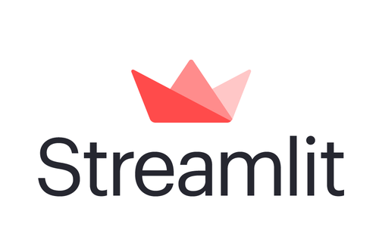
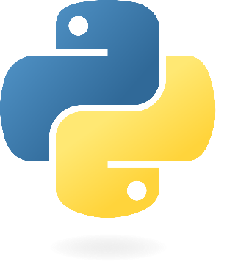

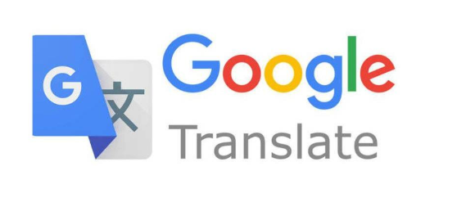
Tools and Technologies
Python 3.8+
Streamlit (Web Interface)
Google Gemini AI (Language Model)
SpeechRecognition (Voice Input)
pyttsx3 (Text-to-Speech)
gTTS (Google Text-to-Speech)
Google Translate API (Multilingual Support)

Slide 7
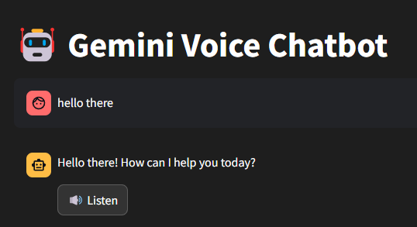
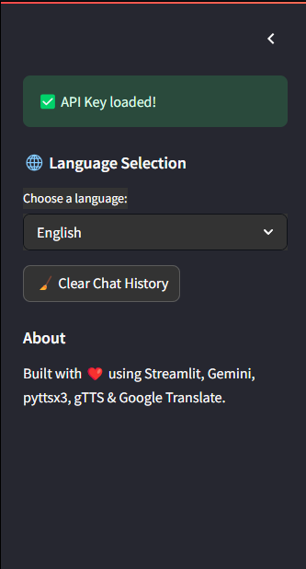
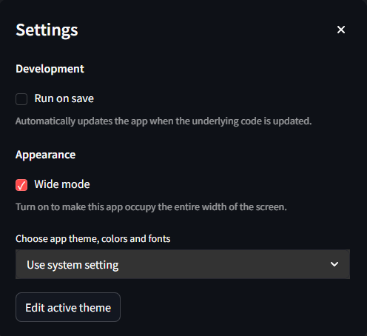
User Interface
Streamlit Web Interface
Chat history display
Input methods (voice/text)
Response playback controls
Settings and preferences
Error messages and notifications

Slide 8
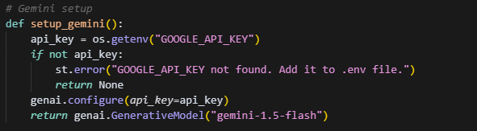
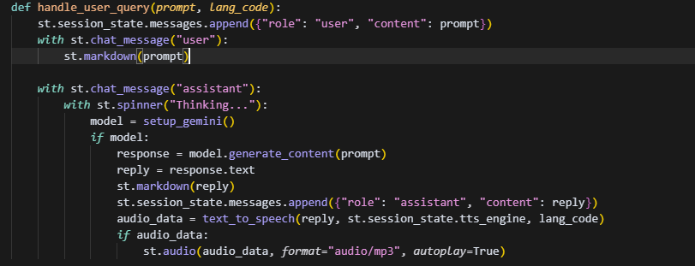
Implementation – AI Integration
Gemini AI Integration
API key management
Request handling
Response processing
Context management
Error handling
Rate limiting

Slide 9
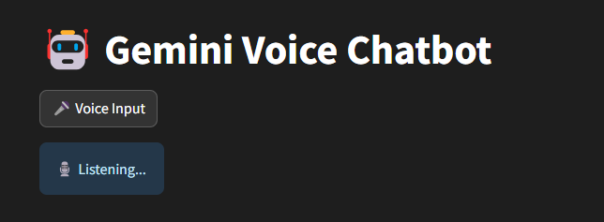
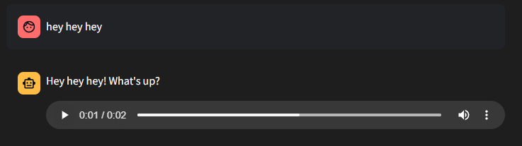
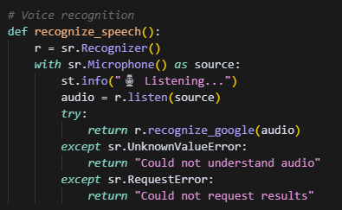
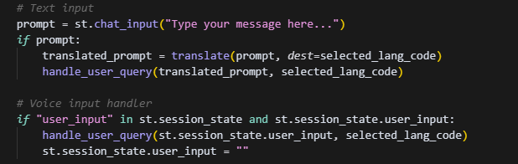
Implementation – Voice Input
Voice Recognition System
Microphone input processing
Speech-to-text conversion
Noise reduction
Real-time voice recognition
Error handling and retry mechanisms

Slide 10
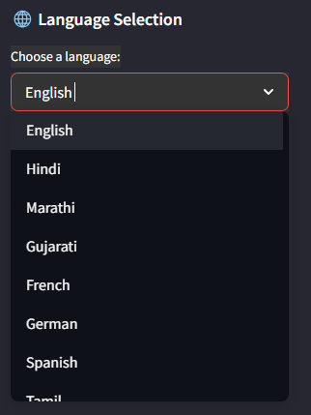

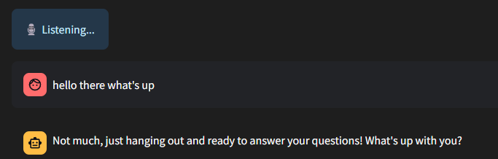
Implementation : Text - to - Speech
Speech Synthesis
Response formatting
Voice selection
Speech rate control
Audio playback
Error handling

Slide 11
Result Analysis
Performance & Accuracy:
Voice recognition consistently identifies user input under normal acoustic conditions.
Gemini responses are context-aware, informative, and adapt well to diverse prompts.
Multilingual Capability:
Successfully handles language translation and voice output for 10+ languages.
Real-time translation maintains user intent across language boundaries.
Response Time:
Average response time (voice input → TTS output): 3–5 seconds
Minimal latency observed in streaming replies or audio playback.
User Experience:
Voice + text interaction improves accessibility and engagement.
Dark mode UI and language switching enhance usability and inclusiveness.

Slide 12
Future Enhancements
Custom Voice Tones: Integration with advanced TTS engines like Amazon Polly or ElevenLabs for premium voices.
Offline Mode: Bundle offline STT and TTS modules to work without internet.
Mobile App Integration: Convert the project into a mobile or progressive web app for greater accessibility.
Login and User Sessions: Enable saving conversation logs per user for continuity.
Expanded Language Support: Add regional dialects and code-switching capabilities.
Emotion Detection: Use sentiment analysis to generate emotionally aware responses or voice tones.
AI Model Expansion: Combine Gemini with other models (e.g., Whisper, GPT) for hybrid capabilities.

Slide 13
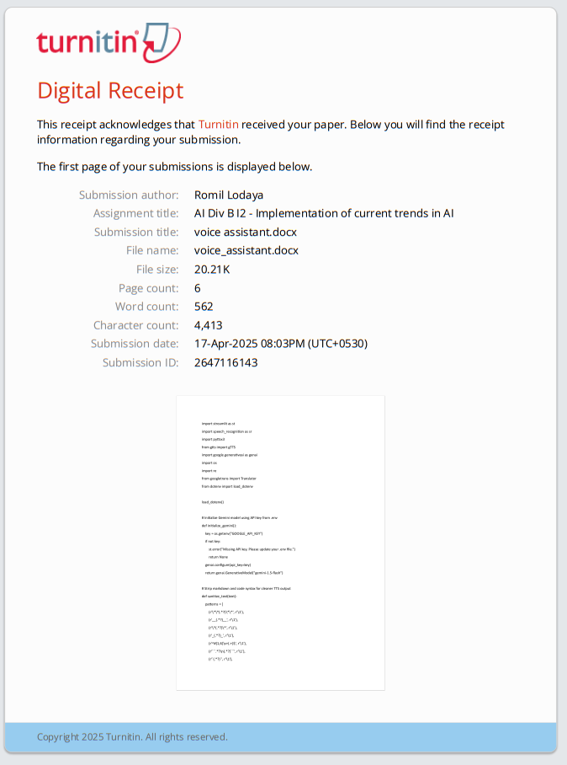
Turnitin Report

Slide 14
Conclusion
Delivered a real-time, voice-interactive chatbot capable of natural communication.
Used Google Gemini for robust AI capabilities and modern NLP interaction.
Multilingual support and TTS playback create a highly inclusive user experience.
Code is modular, scalable, and well-suited for future extensions.
Demonstrated end-to-end integration of AI, voice processing, translation, and web technologies.
Opens up possibilities for accessibility-focused applications, educational tools, and AI-powered assistants.

Slide 15
THANK YOU

